Slide 1
UNIT -1 Introduction to Python
Dr.Preethi.N

Slide 2
Language Fundamentals
Introduction
Python is a general purpose high level programming language.
Python was developed by Guido Van Rossam in 1989 while working at National Research Institute at Netherlands.
But officially Python was made available to public in 1991. The official Date of Birth for Python is : Feb 20th 1991.
Python is recommended as first programming language for beginners.

Slide 3
The name Python was selected from the TV Show
"The Complete Monty Python's Circus",
which was broadcasted in BBC from 1969 to 1974.
Guido developed Python language by taking almost all programming features from different languages
1. Functional Programming Features from C
2. Object Oriented Programming Features from C++
3. Scripting Language Features from Perl and Shell Script
4. Modular Programming Features from Modula-3
Most of syntax in Python Derived from C and ABC languages.

Slide 4
Where we can use Python:
We can use everywhere. The most common important application areas are
1. For developing Desktop Applications
2. For developing web Applications
3. For developing database Applications
4. For Network Programming
5. For developing games
6. For Data Analysis Applications
7. For Machine Learning
8. For developing Artificial Intelligence Applications
9. For IOT ...
Note:
Internally Google and Youtube use Python coding
NASA and Nework Stock Exchange Applications developed by Python.
Top Software companies like Google, Microsoft, IBM, Yahoo using Python.

Slide 5
Features of Python:
1. Simple and easy to learn:
Python is a simple programming language.
When we read Python program, we can feel like reading english statements.
The syntaxes are very simple and only 33 keywords are available.
When compared with other languages, we can write programs with very less number of lines.
Hence more readability and simplicity. We can reduce development and cost of the project.
2. Freeware and Open Source:
We can use Python software without any licence and it is freeware.
Its source code is open, so that we can we can customize based on our requirement.
Eg: Jython is customized version of Python to work with Java Applications.

Slide 6
3. High Level Programming language:
Python is high level programming language and hence it is programmer friendly language.
Being a programmer we are not required to concentrate low level activities like memory management and security etc..
4. Platform Independent:
Once we write a Python program, it can run on any platform without rewriting once again.
Internally PVM is responsible to convert into machine understandable form.
5. Portability:
Python programs are portable. ie we can migrate from one platform to another platform very easily.
Python programs will provide same results on any paltform.
Notes:
. Platform Independent:
Once we write a Python program,it can run on any platform without rewriting once again. Internally PVM is responsible to convert into machine understandable form.
5. Portability:

Slide 7
6. Dynamically Typed:
In Python we are not required to declare type for variables.
Whenever we are assigning the value, based on value, type will be allocated automatically.
Hence Python is considered as dynamically typed language.
But Java, C etc are Statically Typed Languages b'z we have to provide type at the beginning only.
This dynamic typing nature will provide more flexibility to the programmer.
7. Both Procedure Oriented and Object Oriented:
Python language supports both Procedure oriented (like C, pascal etc) and object oriented (like C++,Java) features.
Hence we can get benefits of both like security and reusability etc
8. Interpreted:
We are not required to compile Python programs explcitly.
Internally Python interpreter will take care that compilation.
If compilation fails interpreter raised syntax errors. Once compilation success then PVM (Python Virtual Machine) is responsible to execute.

Slide 8
9. Extensible:
We can use other language programs in Python.
The main advantages of this approach are:
We can use already existing legacy non-Python code
We can improve performance of the application
10. Embedded:
We can use Python programs in any other language programs.
i.e we can embedd Python programs anywhere.
11. Extensive Library:
Python has a rich inbuilt library.
Being a programmer we can use this library directly and we are not responsible to implement the functionality. etc

Slide 9
Limitations of Python:
1. Performance wise not up to the mark because it is interpreted language
2. Not using for mobile Applications
Flavors of Python:
1.CPython:
It is the standard flavor of Python. It can be used to work with C lanugage Applications
2. Jython or JPython:
It is for Java Applications. It can run on JVM
3. IronPython:
It is for C#.Net platform

Slide 10
4.PyPy:
The main advantage of PyPy is performance will be improved because JIT compiler is available inside PVM.
5.RubyPython
For Ruby Platforms
6. AnacondaPython
It is specially designed for handling large volume of data processing.

Slide 11
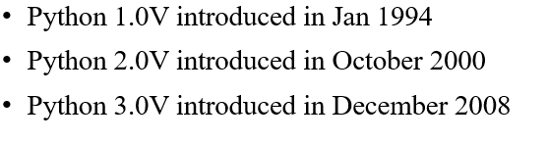
Python Versions:
Python 3.9.0
Release Date: Oct. 5, 2020
This is the stable release of Python 3.9.0
Python 3.9.0 is the newest major release of the Python programming language, and it contains many new features and optimizations.

Slide 12
Install Python
PYTHON
https://www.python.org/getit/
Jupyter notebook

Slide 13
Identifiers
A name in Python program is called identifier. It can be class name or function name or module name or variable name.
a = 10
Rules to define identifiers in Python:
1. The only allowed characters in Python are
alphabet symbols(either lower case or upper case)
digits(0 to 9)
underscore symbol(_)
By mistake if we are using any other symbol like $ then we will get syntax error.
cash = 10 √
ca$h =20 X

Slide 14
2. Identifier should not starts with digit
123total X
total123 √
3. Identifiers are case sensitive. Of course Python language is case sensitive language.
total=10
TOTAL=999
print(total) #10
print(TOTAL) #999

Slide 15
Identifier:
1. Alphabet Symbols (Either Upper case OR Lower case)
2. If Identifier is start with Underscore (_) then it indicates it is private.
3. Identifier should not start with Digits.
4. Identifiers are case sensitive.
5. We cannot use reserved words as identifiers . Eg: def=10 X
6. There is no length limit for Python identifiers. But not recommended to use too lengthy identifiers.
7. Dollor ($) Symbol is not allowed in Python.

Slide 16
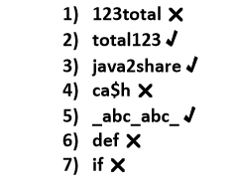
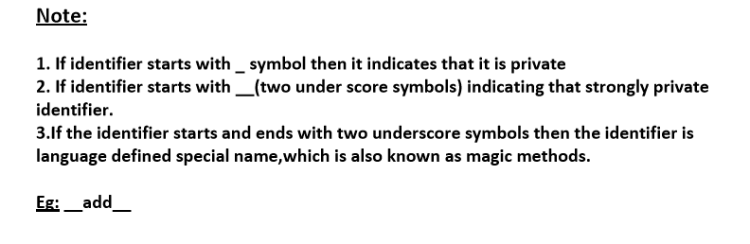
Q. Which of the following are valid Python identifiers?

Slide 17
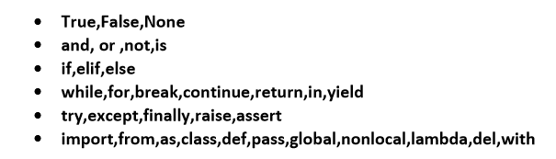
Reserved Words
In Python some words are reserved to represent some meaning or functionality. Such type of words are called Reserved words.
There are 33 reserved words available in Python.

Slide 18
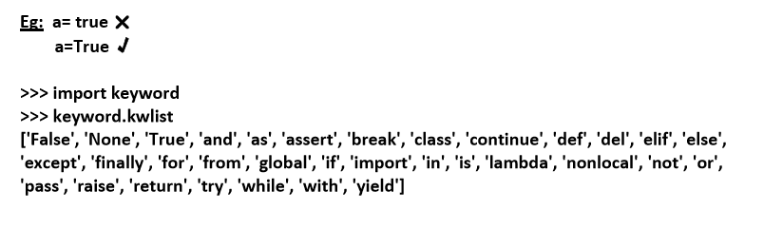
Note:
1. All Reserved words in Python contain only alphabet symbols.
2. Except the following 3 reserved words, all contain only lower case alphabet symbols.

Slide 19
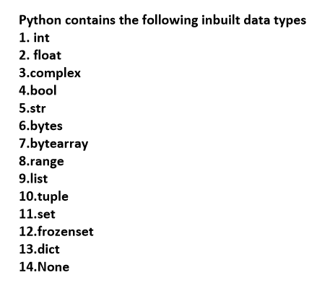
Data Types
Data Type represent the type of data present inside a variable.
In Python we are not required to specify the type explicitly.
Based on value provided, the type will be assigned automatically.
Hence Python is Dynamically Typed Language.

Slide 20
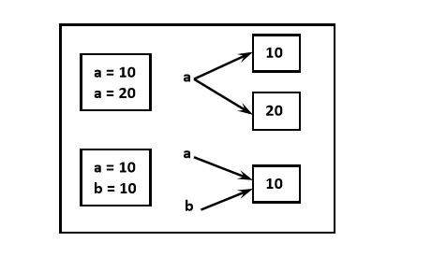
Note: Python contains several inbuilt functions
1.type()
to check the type of variable
2. id()
to get address of object
3. print()
to print the value
In Python everything is object

Slide 21
int data type:
We can use int data type to represent whole numbers (integral values)
Eg:
a=10
type(a) #int
Note:
In Python3 there is no long type explicitly and we can represent long values also by using int type only.

Slide 22
We can represent int values in the following ways
1. Decimal form
2. Binary form
3. Octal form
4. Hexa decimal form

Slide 23
1. Decimal form(base-10):
It is the default number system in Python
The allowed digits are: 0 to 9
Eg: a =10
2. Binary form(Base-2):
The allowed digits are : 0 & 1
Literal value should be prefixed with 0b or 0B
Eg: a = 0B1111
a =0B123
a=b111

Slide 24
3. Octal Form(Base-8):
The allowed digits are : 0 to 7
Literal value should be prefixed with 0o or 0O.
Eg: a=0o123
a=0o786
4. Hexa Decimal Form(Base-16):
The allowed digits are : 0 to 9,
a-f (both lower and upper cases are allowed)
Literal value should be prefixed with 0x or 0X
Eg: a =0XFACE
a=0XBeef
a =0XBeer

Slide 25
Note: Being a programmer we can specify literal values in decimal, binary, octal and hexa decimal forms. But PVM will always provide values only in decimal form.
a=10
b=0o10
c=0X10
d=0B10
print(a)10
print(b)8
print(c)16
print(d)2

Slide 26
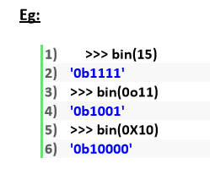
Base Conversions
Python provide the following in-built functions for base conversions
1.bin():
We can use bin() to convert from any base to binary

Slide 27
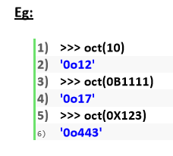
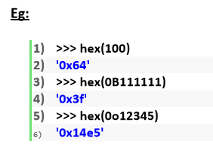
2. oct():
We can use oct() to convert from any base to octal
3. hex():
We can use hex() to convert from any base to hexa decimal

Slide 28


float data type:
The main advantage of exponential form is we can represent big values in less memory.
We can also represent floating point values by using exponential form (scientific notation)
The main advantage of exponential form is we can represent big values in less memory.

Slide 29
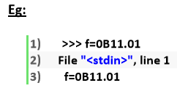
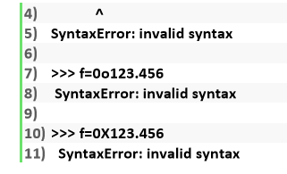
***Note: We can represent int values in decimal, binary, octal and hexa decimal forms. But we can represent float values only by using decimal form.

Slide 30
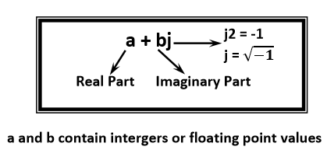
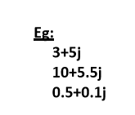
Complex Data Type:
A complex number is of the form

Slide 31
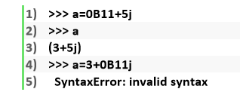
In the real part if we use int value then we can specify that either by decimal,octal,binary or hexa decimal form.
But imaginary part should be specified only by using decimal form.

Slide 32
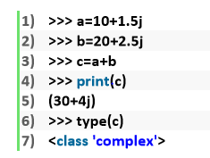
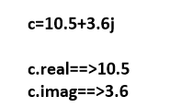
Even we can perform operations on complex type values.
Note: Complex data type has some inbuilt attributes to retrieve the real part and imaginary part
We can use complex type generally in scientific Applications and electrical engineering Applications.

Slide 33
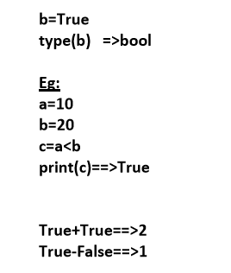
4.bool data type:
We can use this data type to represent boolean values.
The only allowed values for this data type are: True and False
Internally Python represents True as 1 and False as 0

Slide 34
str type:
A String is a sequence of characters enclosed within single quotes or double quotes.
s1 =‘python’
s1= “python”
By using single quotes or double quotes we cannot represent multi line string literals.
s1=“python code”
For this requirement we should go for triple single quotes(''') or triple double quotes(""")
s1='''python code'''
s1=""" python code"""

Slide 35
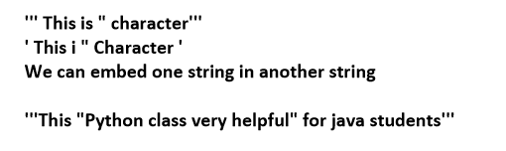
We can also use triple quotes to use single quote or double quote in our String.

Slide 36
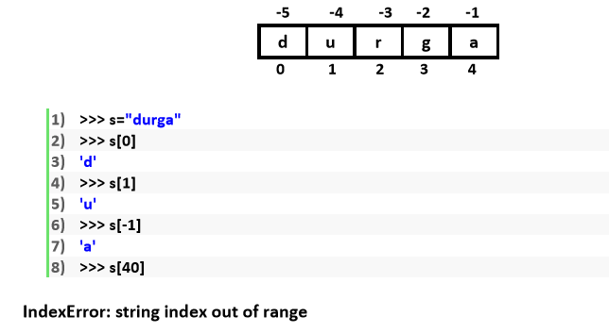
Slicing of Strings:
slice means a piece
[ ] operator is called slice operator, which can be used to retrieve parts of String.
In Python Strings follows zero based index.
The index can be either +ve or -ve.
+ve index means forward direction from Left to Right
-ve index means backward direction from Right to Left

Slide 37
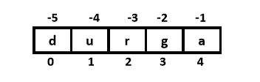
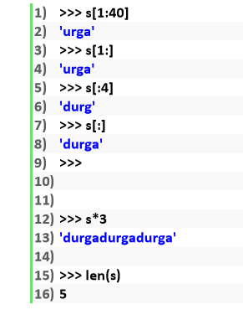

Slide 38
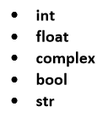
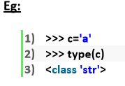
Note:
1. In Python the following data types are considered as Fundamental Data types
2. In Python,we can represent char values also by using str type and explicitly char type is not available.
3. In Python we can present char Value also by using str Type and explicitly char Type is not available.

Slide 39
Fundamental Data Types ( Immutability )

Slide 40
Fundamental Data Types (Immutability: )
All Fundamental Data types are immutable. i.e once we creates an object, we cannot perform any changes in that object.
If we are trying to change then with those changes a new object will be created. This non-changeable behavior is called immutability.
In Python if a new object is required, then PVM wont create object immediately.
First it will check is any object available with the required content or not.
If available then existing object will be reused. If it is not available then only a new object will be created. The advantage of this approach is memory utilization and performance will be improved.
But the problem in this approach is, several references pointing to the same object, by using one reference if we are allowed to change the content in the existing object then the remaining references will be effected.
To prevent this ,immutability concept is required. According to this once creates an object we are not allowed to change content. If we are trying to change with those changes a new object will be created.

Slide 41
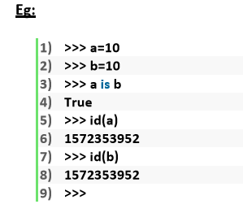
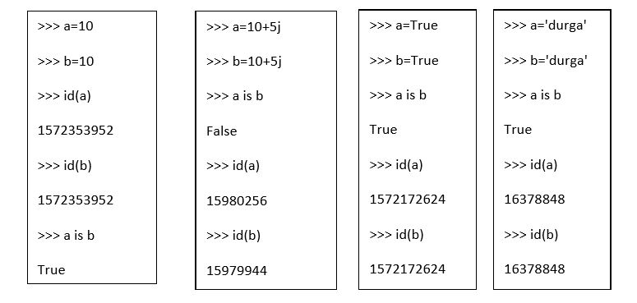

Slide 42
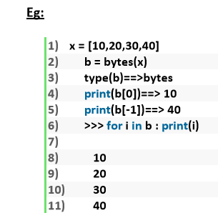
bytes Data Type:
bytes data type represents a group of byte numbers just like an array.

Slide 43
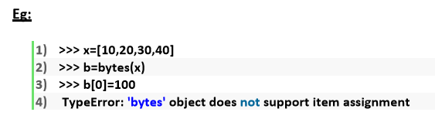
Conclusion 1:
The only allowed values for byte data type are 0 to 256. By mistake if we are trying to provide any other values then we will get value error.
Conclusion 2:
Once we creates bytes data type value, we cannot change its values, otherwise we will get TypeError

Slide 44
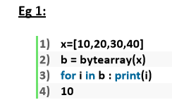
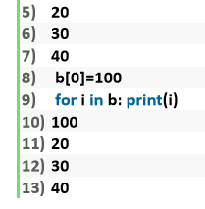
bytearray Data type:
bytearray is exactly same as bytes data type except that its elements can be modified.

Slide 45
list data type:
If we want to represent a group of values as a single entity where insertion order required to preserve and duplicates are allowed then we should go for list data type.
1. insertion order is preserved
2. heterogeneous objects are allowed
3. duplicates are allowed
4. Growable in nature
5. values should be enclosed within square brackets.

Slide 46
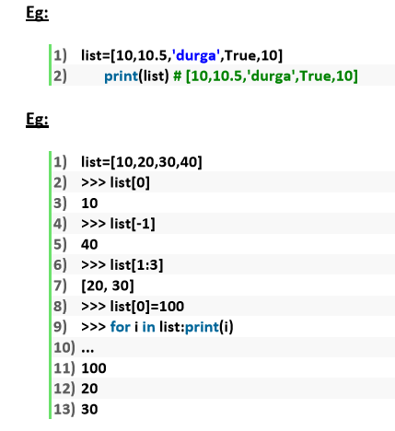


Slide 47
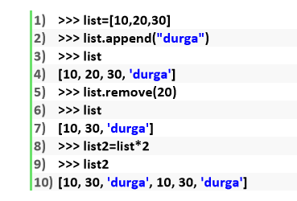
list is growable in nature. i.e based on our requirement we can increase or decrease the size.
Note: An ordered, mutable, heterogenous collection of elements is nothing but list, where duplicates also allowed

Slide 48
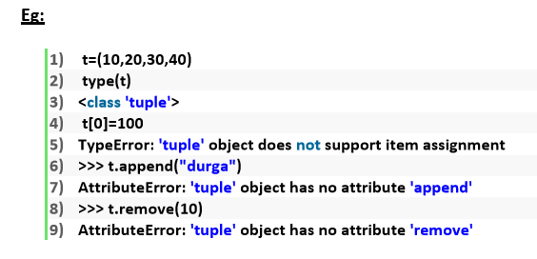
tuple data type:
tuple data type is exactly same as list data type except that it is immutable. i.e we cannot change values.
Tuple elements can be represented within parenthesis.
Note: tuple is the read only version of list

Slide 49
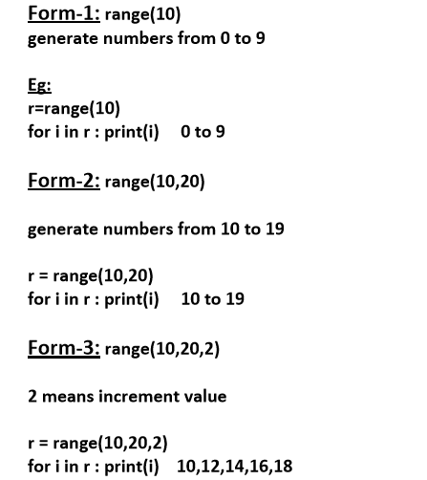
range Data Type:
range Data Type represents a sequence of numbers. The elements present in range Data type are not modifiable. i.e range Data type is immutable.

Slide 50

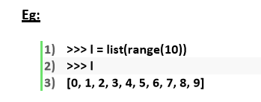
We can access elements present in the range Data Type by using index.
We cannot modify the values of range data type

Slide 51
set Data Type:
If we want to represent a group of values without duplicates where order is not important then we should go for set Data Type.
1. insertion order is not preserved
2. duplicates are not allowed
3. heterogeneous objects are allowed
4. index concept is not applicable
5. It is mutable collection
6. Growable in nature

Slide 52
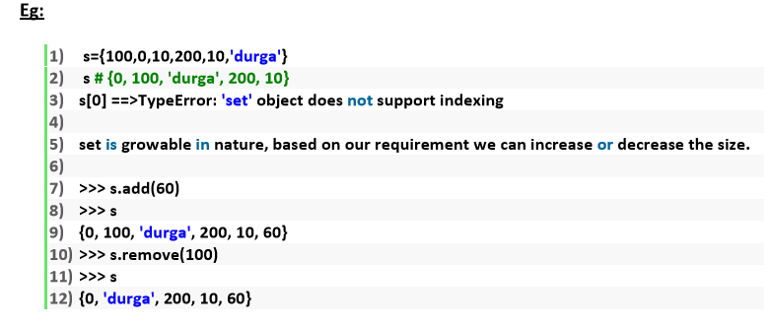

Slide 53
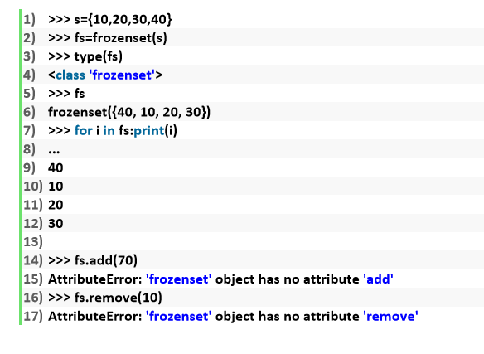
frozenset Data Type:
It is exactly same as set except that it is immutable. Hence we cannot use add or remove functions.

Slide 54

dict Data Type:
If we want to represent a group of values as key-value pairs then we should go for dict data type.
Duplicate keys are not allowed but values can be duplicated. If we are trying to insert an entry with duplicate key then old value will be replaced with new value.

Slide 55
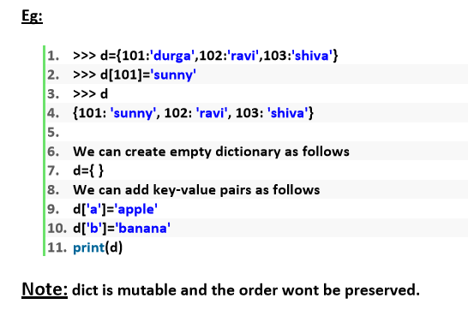
Note:
In general we can use bytes and bytearray data types to represent binary information like images,video files etc
In Python there is no char data type. Hence we can represent char values also by using str type.

Slide 56
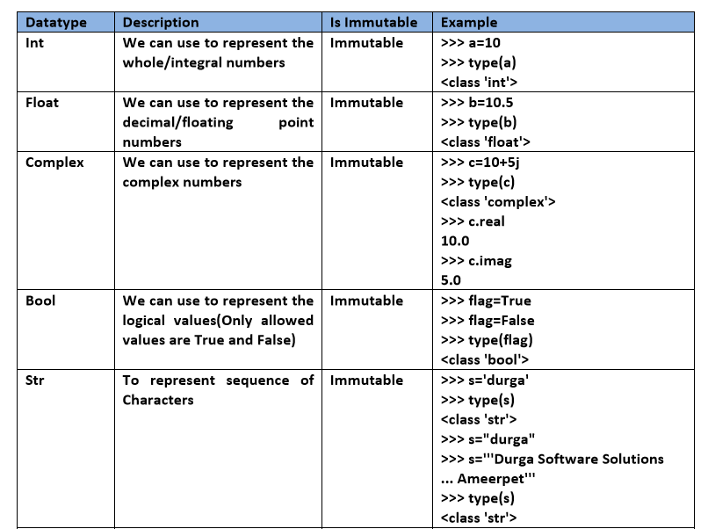
Summary of Datatypes in Python3

Slide 57
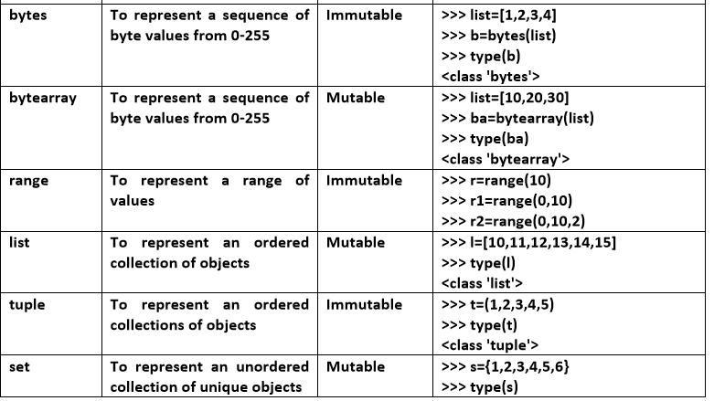

Slide 58
 | PROPERTY | LIST[ ] | TUPLE( ) | SET{ } | DICT{ }
1 | Insertion order | yes | yes | No | No
2 | Duplicated object | yes | yes | No | No
3 | Heterogenous | yes | yes | yes | yes
4 | Immutable | mutable | Immutable | mutable | mutable
5 | Index/slicing | yes | yes | No | No
Range : Immutable
Frozenset : Immutable

Slide 59
String Data Type

Slide 60
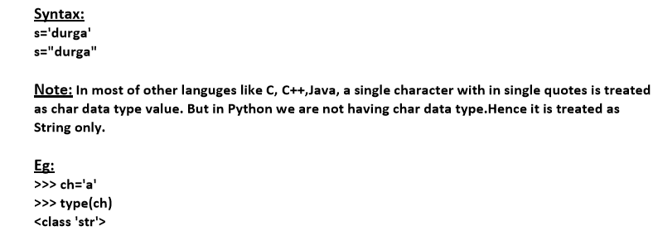
String Data Type
The most commonly used object in any project and in any programming language is String only. Hence we should aware complete information about String data type.
What is String?
Any sequence of characters within either single quotes or double quotes is considered as a String.

Slide 61
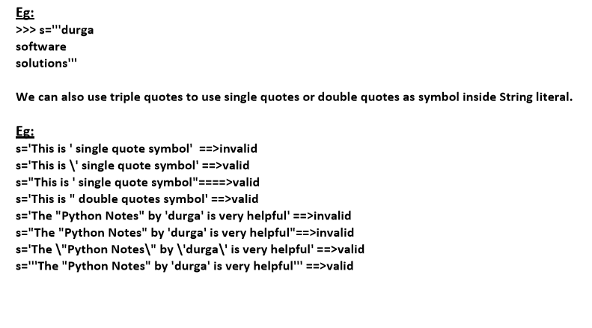
How to define multi-line String literals:
We can define multi-line String literals by using triple single or double quotes.

Slide 62
How to access characters of a String:
We can access characters of a string by using the following ways.
1. By using index
2. By using slice operator

Slide 63
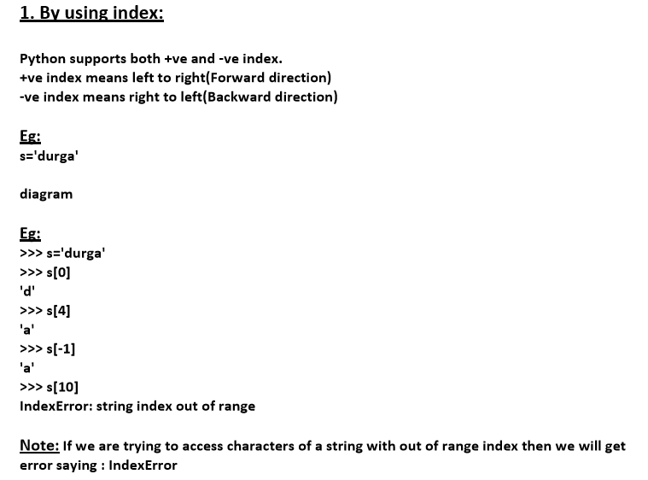

Slide 64
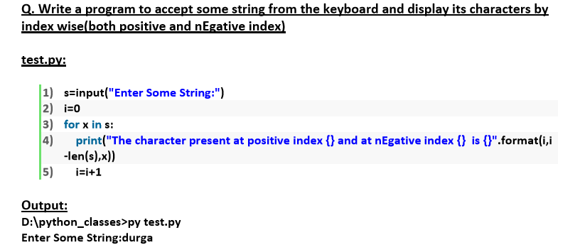
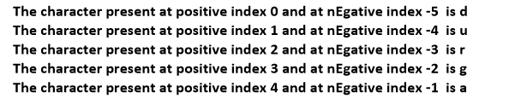

Slide 65
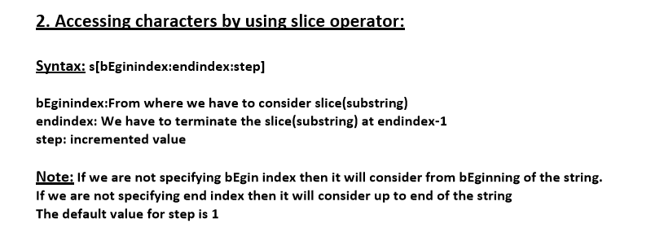
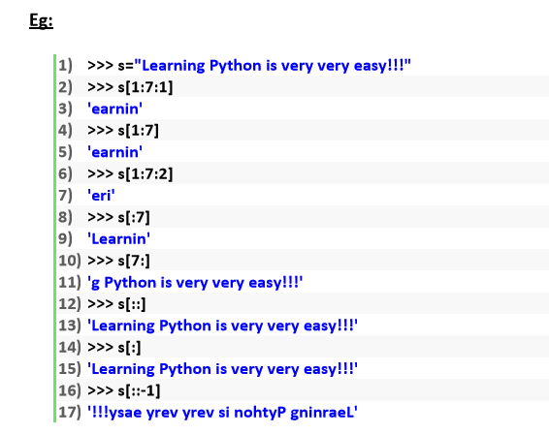

Slide 66
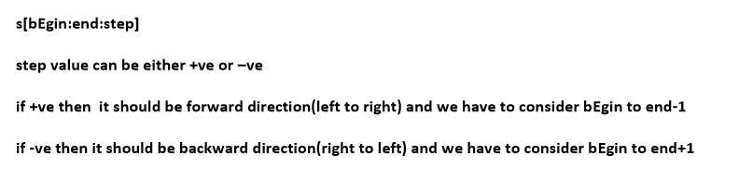
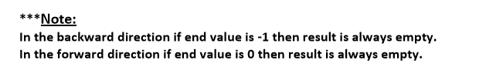
Behaviour of slice operator:

Slide 67
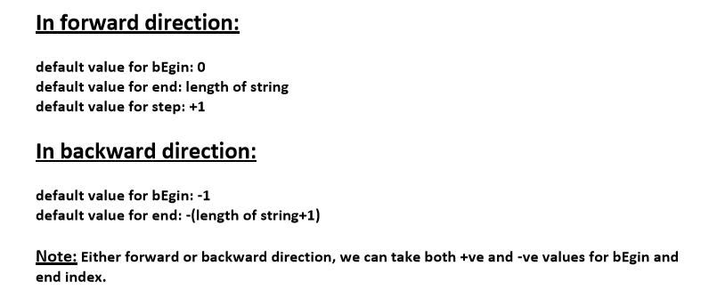

Slide 68


Slide 69




Slide 70




Slide 71


Comparison of Strings:

Slide 72

Removing spaces from the string:

Slide 73



Slide 74


min(“string”) :- This function returns the minimum value alphabet from string.
max(“string”) :- This function returns the maximum value alphabet from string.

Slide 75





Slide 76


Slide 77




Slide 78



Slide 79



Slide 80


Counting substring in the given String:

Slide 81

Replacing a string with another string:

Slide 82
Q. String objects are immutable then how we can change the content by using replace() method.
Once we creates string object, we cannot change the content. This non changeable behaviour is nothing but immutability.
If we are trying to change the content by using any method, then with those changes a new object will be created and changes won't be happend in existing object.
Hence with replace() method also a new object got created but existing object won't be changed

Slide 83

In the above example, original object is available and we can see new object which was created because of replace() method.

Slide 84


Splitting of Strings:

Slide 85


Joining of Strings:

Slide 86

Changing case of a String:

Slide 87


Slide 88


Checking starting and ending part of the string:

Slide 89

To check type of characters present in a string:

Slide 90


Slide 91




Slide 92

Formatting the Strings:

Slide 93


Important Programs regarding String Concept

Slide 94


Slide 95


Slide 96



Slide 97




Slide 98


Slide 99




Slide 100



Slide 101



Slide 102


Formatting the Strings:

